Slide 1
PUBLIC WORKS

Slide 2
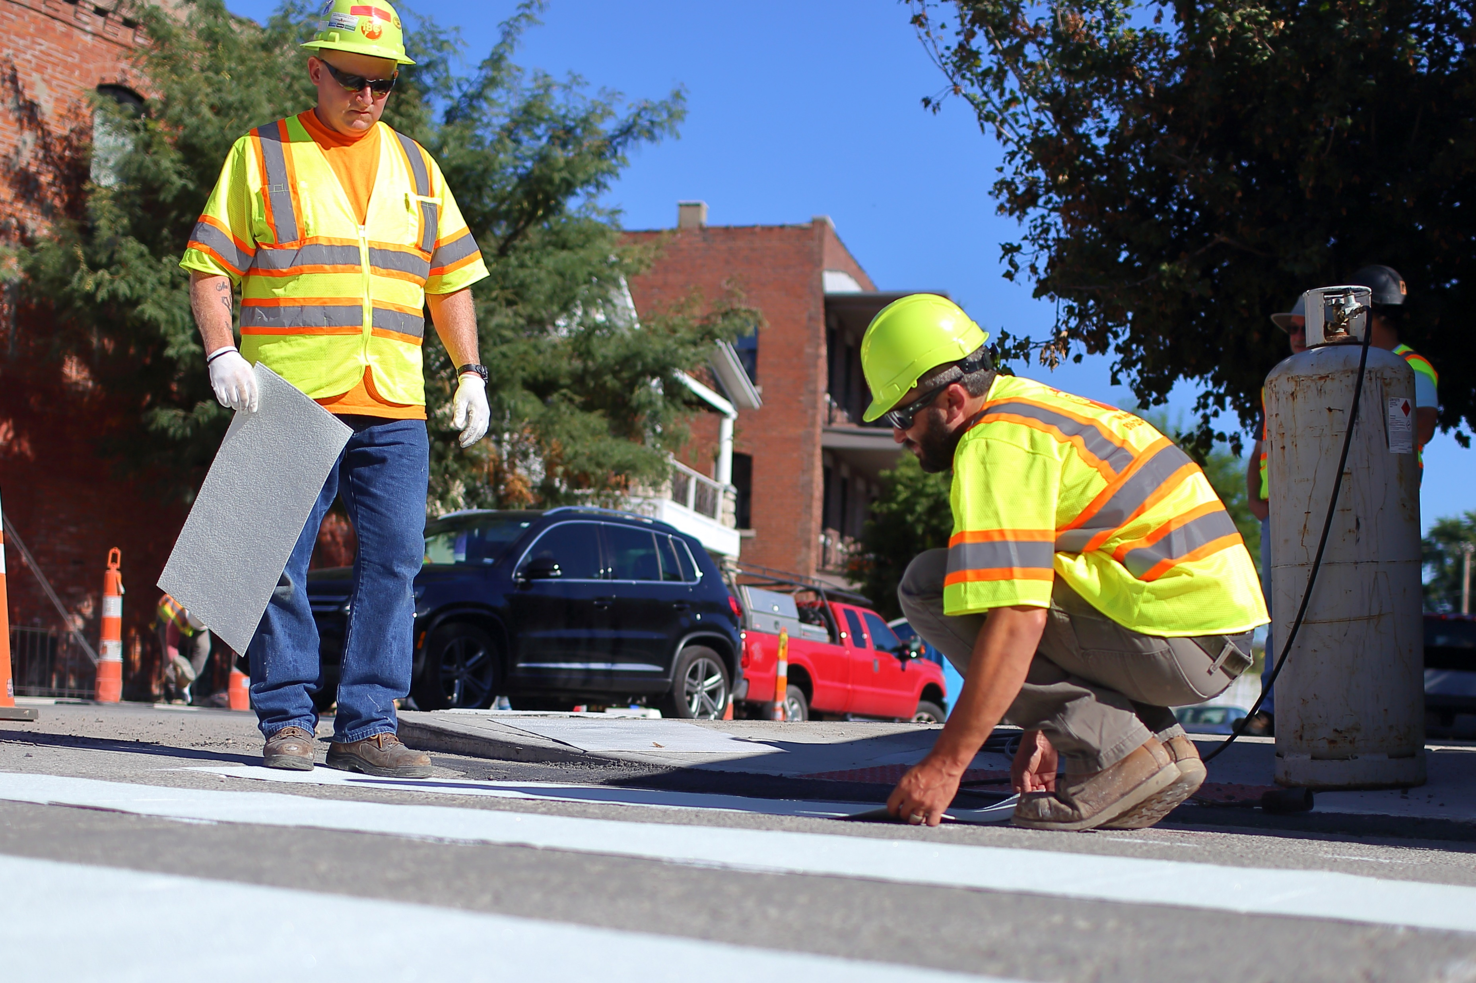
Truman Rd Communications
Community Improvement District Meeting
December 15th, 2022

Slide 3
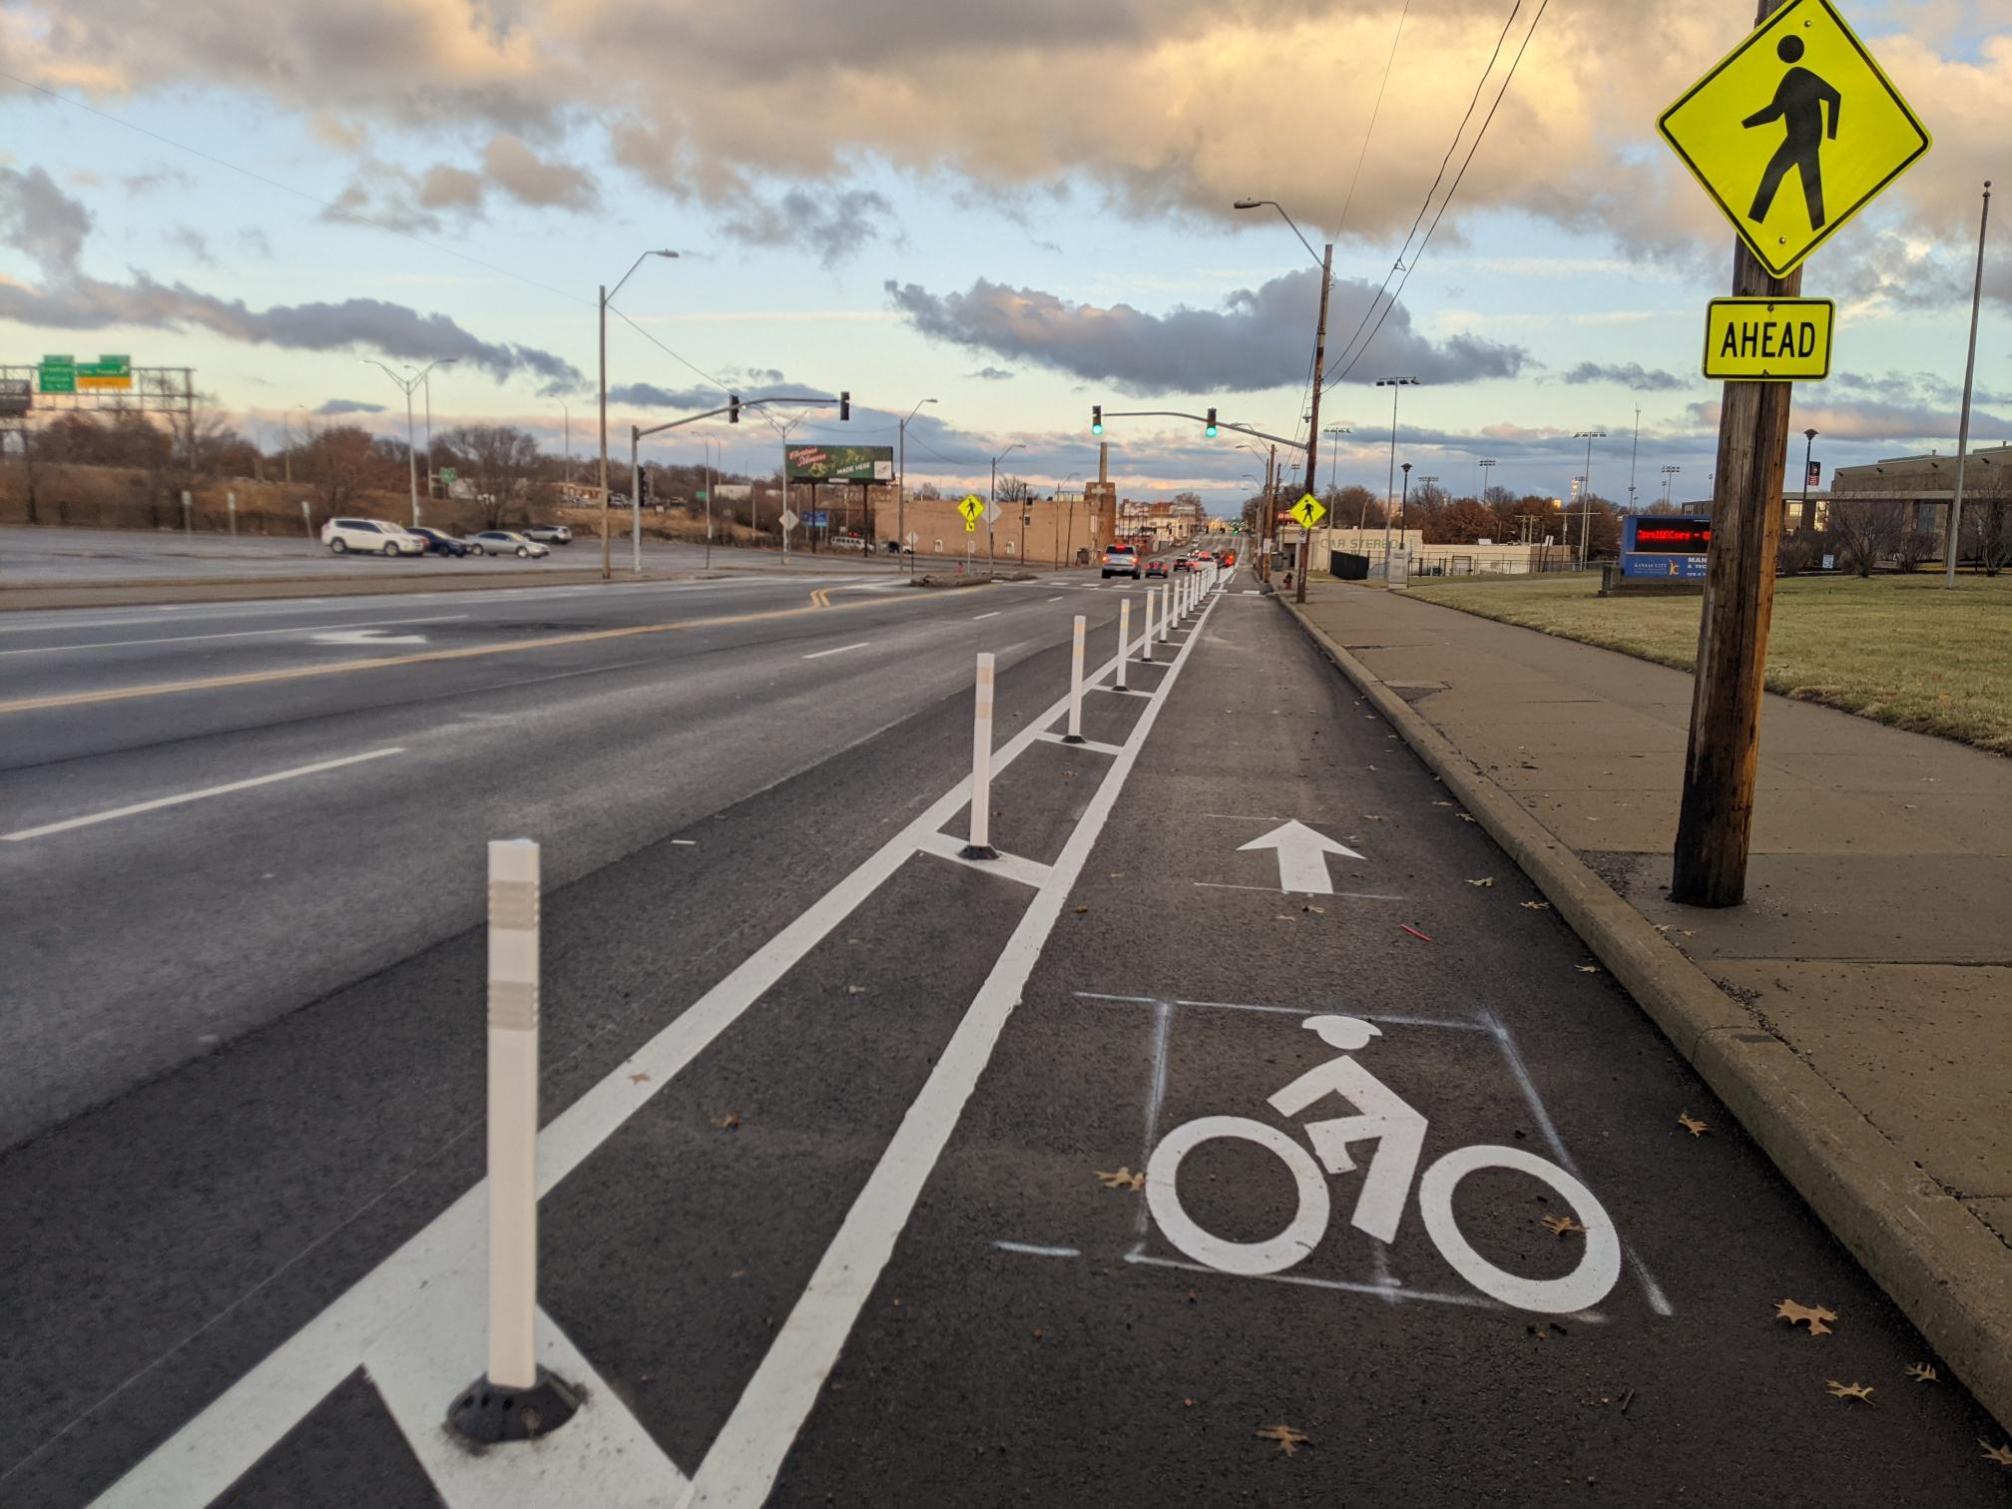
Agenda
Public Works
Why bike lanes on Truman Rd?
Overview of PSP/previous engagement
2022 PBL Engagement
How the street functions now

Slide 4
Why bike lanes on Truman Rd? – 2022 PBL Planning
PUBLIC WORKS
Facility | From | To | Lane Miles | Road Diet | HIN | Area Plan Rec | Connect to Existing | Connect to Proposed
Truman Rd | Holmes | Belmont | 7.05 | Yes | Yes | Yes | Yes | Yes
19th Street | Oak | 18th St/Holmes | 0.95 | No | No | No | Yes | Yes
22nd Street | Gillham Rd | Manchester Trfy | 9.35 | Yes | Yes | Yes | Yes | Yes
27th Street | Campbell St | Van Brunt Blvd | 6.10 | Yes | Yes | No | Yes | No
American Royal | Avenida Cesar Chavez | State Line Rd | 1.00 | No | No | Yes | No | Yes
Cherry St | 3rd St | Charlotte St | 0.75 | No | No | Yes | Yes | Yes
Grand Blvd | 10th St | Truman Rd | 0.82 | No | No | Yes | Yes | Yes
Gregory St | Brookside Rd | Main St | 0.45 | No | No | No | Yes | No
Hickman Mills/Prospect | Paseo Blvd | 85th St | 2.41 | Yes | No | Yes | Yes | Yes
Lexington Ave | Paseo Blvd | Bellefontaine Ave | 2.07 | No | No | Yes | No | No
Longview Pkwy | 107th St | Raytown Rd | 2.12 | No | No | Yes | Yes | Yes
Oak St | 19th Street | 12th Street | 1.30 | Yes | No | No | Yes | Yes
Raytown Rd | E 107th St | Grandview | 3.16 | Yes | No | Yes | Yes | Yes
Wyandotte St | 31st St | Linwood Blvd | 0.48 | No | No | No | No | Yes
Notes:
Previously Planned
Part of HIN Network
Resurfacing program candidate
East-West Multimodal Access

Slide 5
Why bike lanes on Truman Rd? – Vision Zero Coordination
Public Works
2015 – 2020: 360 Injury Crashes (Minor Injury, Serious Injury, Fatal)
14 Involving Pedestrians
2 Involving Bicycles
2015 – 2020: 27 KSI Crashes (Fatal and Serious Injury Only)
2 Involving Pedestrians
1 Involving Bicycle
Notes:
4 people/year are having a life changing traffic crash just in this section of Truman Rd (Holmes to Hardesty)
60 people/year are getting hurt in a crash along this section of Truman Rd

Slide 6
Why bike lanes on Truman Rd? – Previous Planning Efforts
Public Works

Slide 7
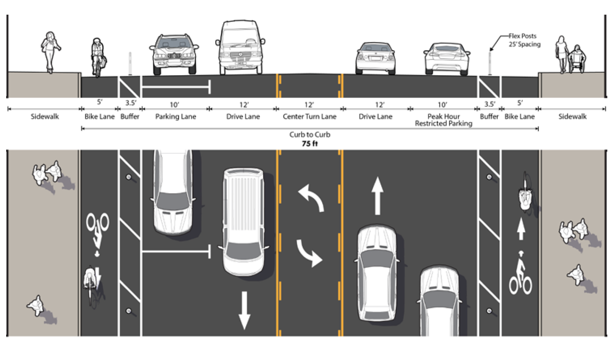
PUBLIC WORKS
Truman Rd Design – from PSP

Slide 8
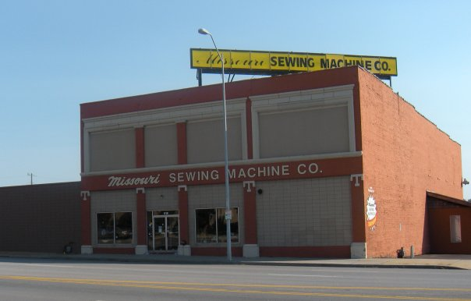
PSP Engagement-Advisory Committee
Public Works
Members/Attendees
Truman Rd CID
Guadalupe Centers
KCMO Public Works
KCMO Planning
KCMO Parks & Rec
KCATA
KCMO Long Range Planning
MoDOT
MARC

Slide 9
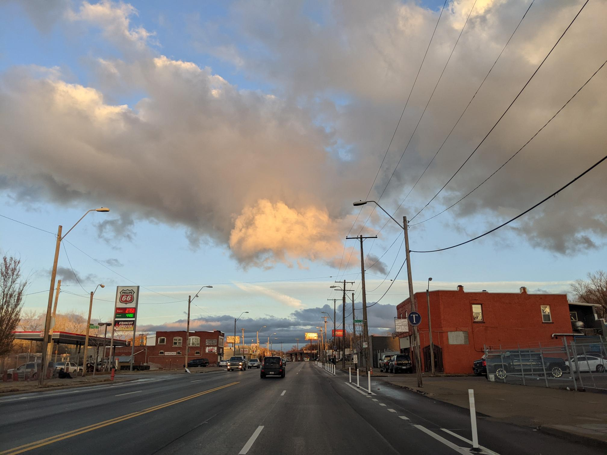
PSP Stakeholder Engagement
Public Works
Manual Career & Technical Center
Guadalupe Centers
US Post Office
MLB Urban Youth Academy
Walker Uniform
Councilman Jermaine Reed
Missouri Sewing Machine
OK Furniture

Slide 10
Public Works
Truman Road Engagement Log - from 2017-2022
 |  | Location | Address
10/5/2017 | Stakeholder Meeting - Manual Career & Technical Center | Manual Career & Technical Center | 1215 E Truman Rd
10/5/2017 | Stakeholder Meeting - Walker Uniform | Phone | 2601 E Truman
10/6/2017 | Stakeholder Meeting - Missouri Sewing Machine | 1011 E Truman | 1011 E Truman
10/6/2017 | Stakeholder Meeting - Commuter | Truman Rd | Ivanhoe Neighborhood
10/10/2017 | Stakeholder Meeting - OK Furniture | OK Furniture | 2522 E Truman Rd
10/10/2017 | Stakeholder Meeting - U.S. Post Office - James Crews Location | U.S. Post Office | 2201 E Truman Rd
10/10/2017 | Stakeholder Meeting - C&S Wood Shop | C&S Wood shop | 2101 E Truman
10/10/2017 | Stakeholder Meeting - Guadalupe Ceters | Guadalupe Centers | 5125 E Truman
10/11/2017 | PSP Advisory Committee #1
10/16/2017 | Stakeholder Meeting - 23rd St PAC Neighborhood | Providence Church | 1925 Hardesty
11/8/2017 | PSP Community Meeting #1 | Manual Career & Technical Center | 1215 E Truman Rd
12/18/2017 | PSP Advisory Committee #2 | Virtual
3/21/2018 | PSP Community Meeting #2 | Gregg Klice Community Center | 1600 John Buck O'Neil Way
3/22/2018 | PSP Advisory Committee Meeting #3 | Gregg Klice Community Center | 1600 John Buck O'Neil Way
4/4/2022 | Notification Mailer sent out to businesses | all 200 addresses along Truman Rd from Holmes to Hardesty
4/11/2022 | Virtual Public Meeting | Microsoft Teams
4/12/2022 | Virtual Public Meeting | Microsoft Teams
4/20/2022 | TI&O City Council Committee | Council Chambers

Slide 11
2022 PBL Engagement - Public Notice Mailer
Public Works
Send to all properties along Truman Rd
200 properties
Mailed out on 4-4-2022
Notes:
See “Truman Rd Mailer address list” for list of addresses
See “PBL Year 1 Public Notification Letter-4-4-22” for what was mailed

Slide 12
2022 PBL Engagement - Public Meetings
Public Works
4-11-2022 6 pm – 7 pm Virtual Public Meeting
4-12-2022 12 pm - 1 pm Virtual Public Meeting
Notes:
See the “4-11-2022 PBL Plan Public Meeting chat” for the chat discussion during that meeting
See the “4-12-2022 PBL Plan Public Meeting chat” for the chat discussion during that meeting

Slide 13
2022 PBL – City Council Approval
Public Works
PBL Year 1 and 5 year network presented to
Approved by TI&O Committee
City Council on 4-20-2022

Slide 15
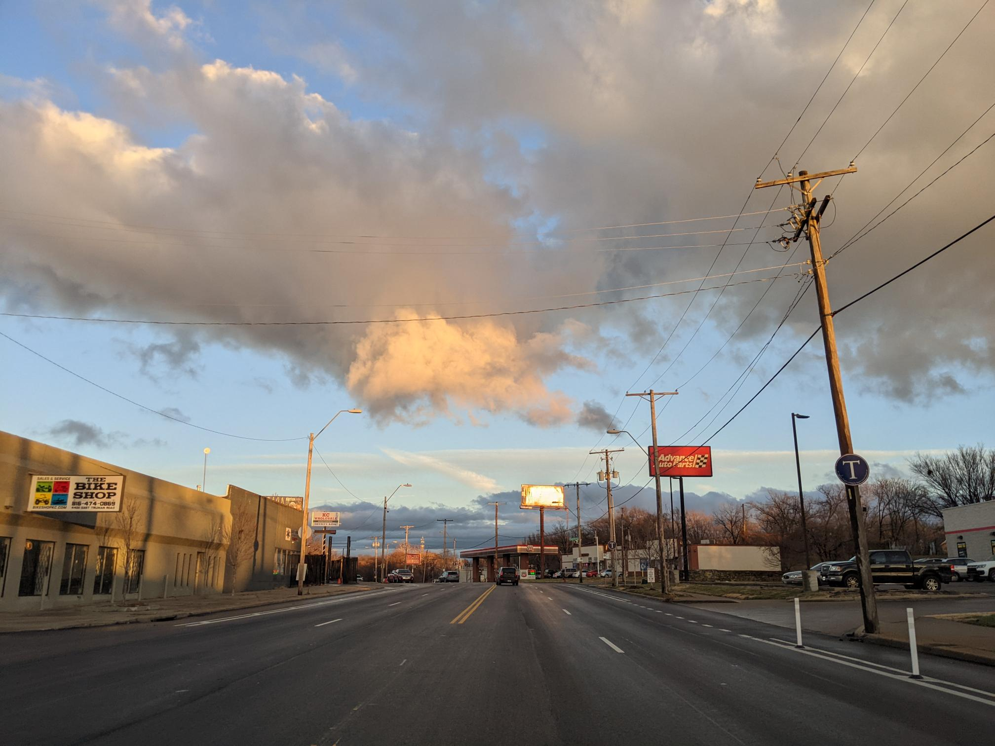
PUBLIC WORKS

